Slide 1
GATE 2025 01 : 6 Marks 4 Question
GATE 2025 02 : 6 Marks 5 Question

Slide 2
GATE 2025 01

Slide 3



Slide 4
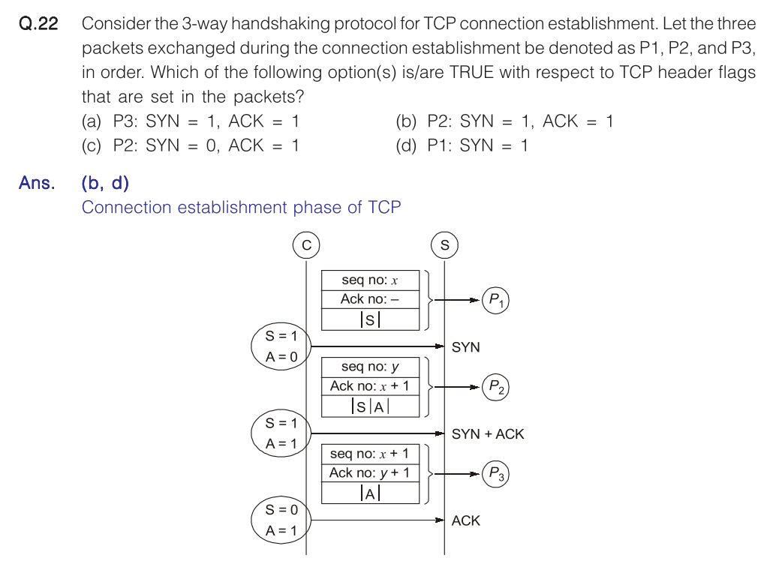

Slide 5
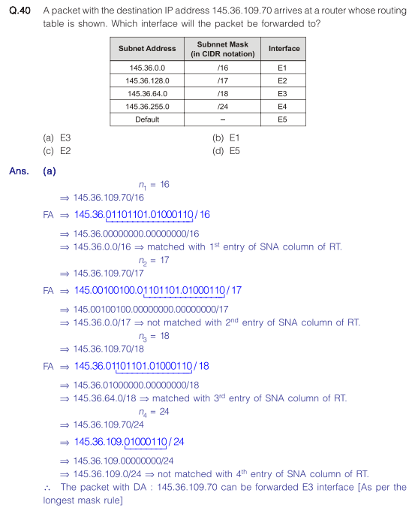

Slide 6
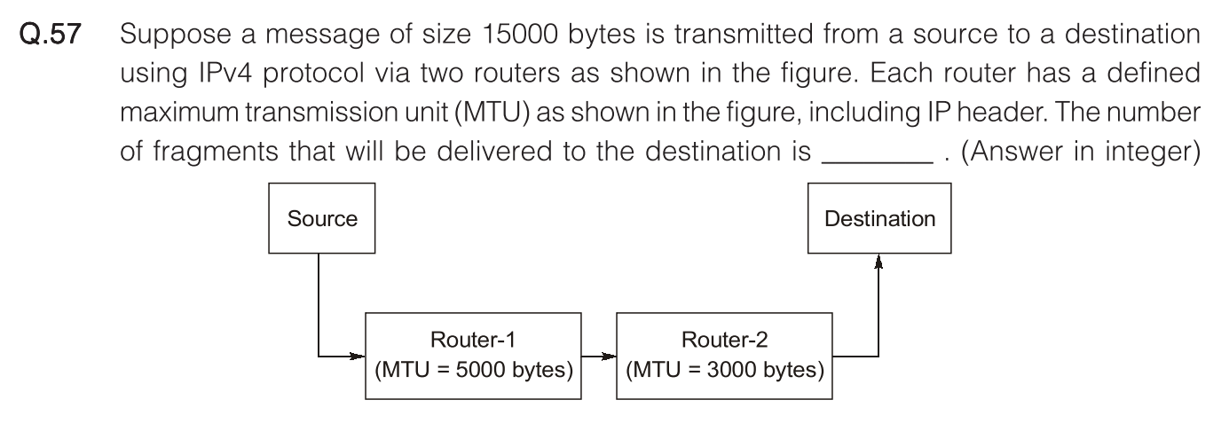
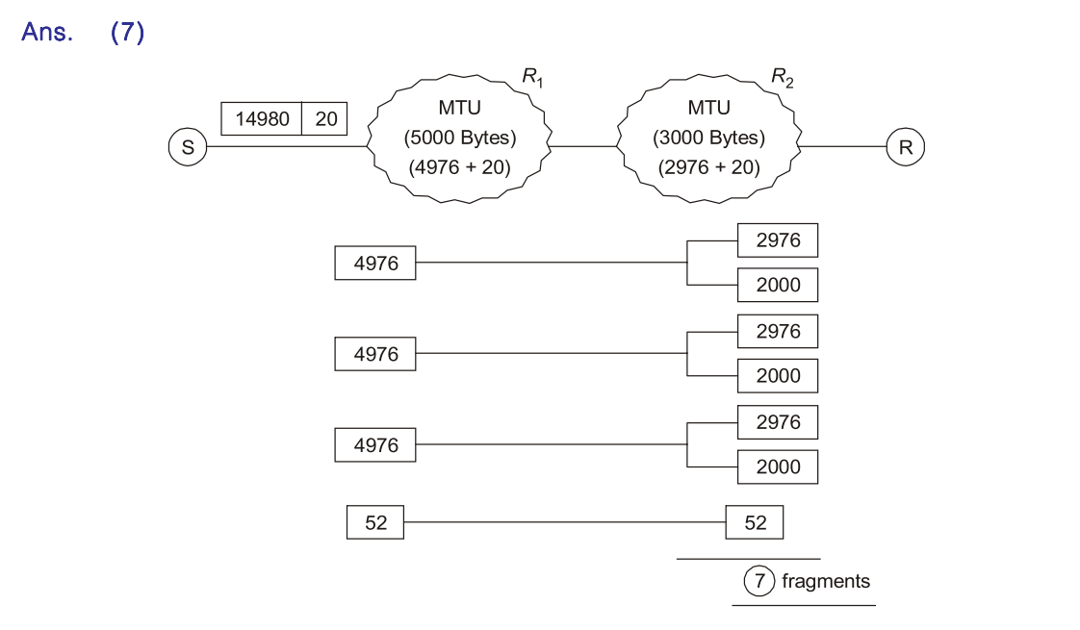

Slide 7
GATE 2025 02

Slide 8
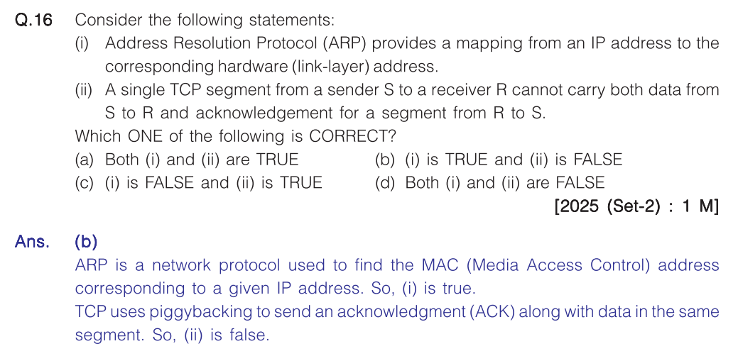

Slide 9
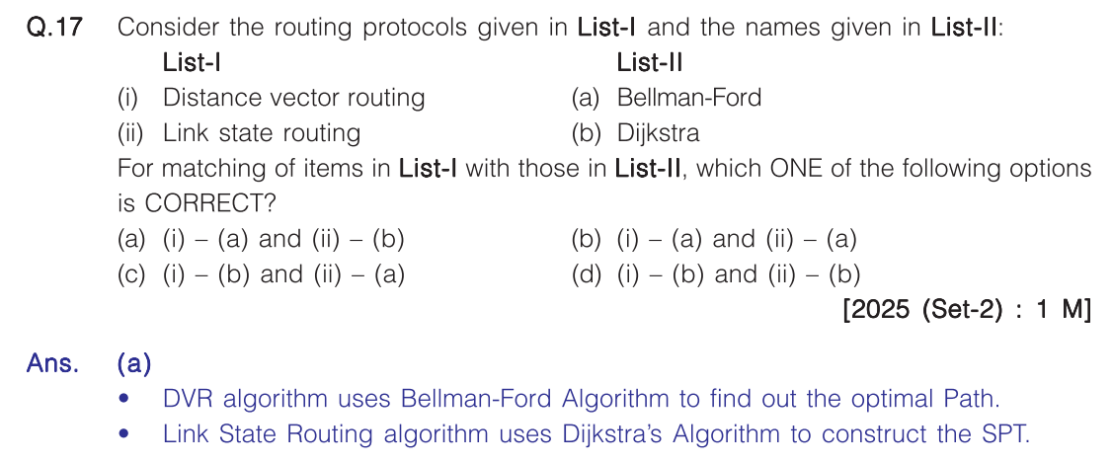

Slide 10
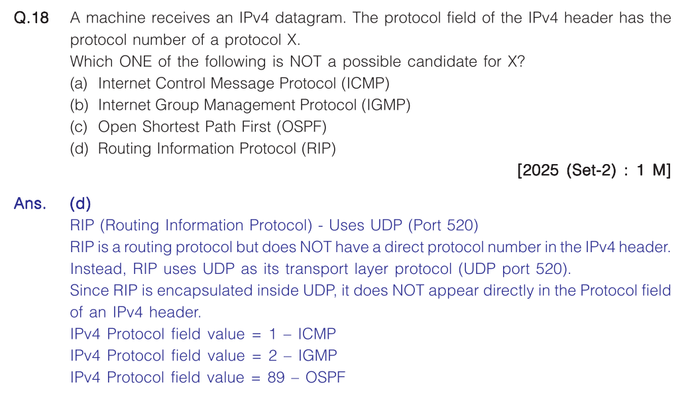

Slide 11
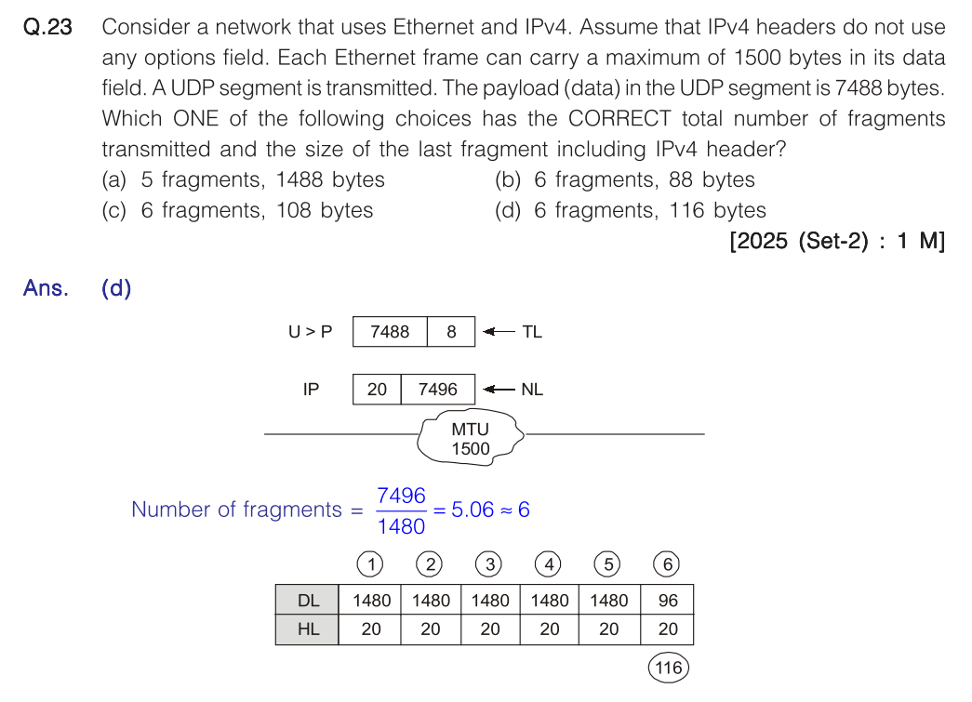

Slide 12
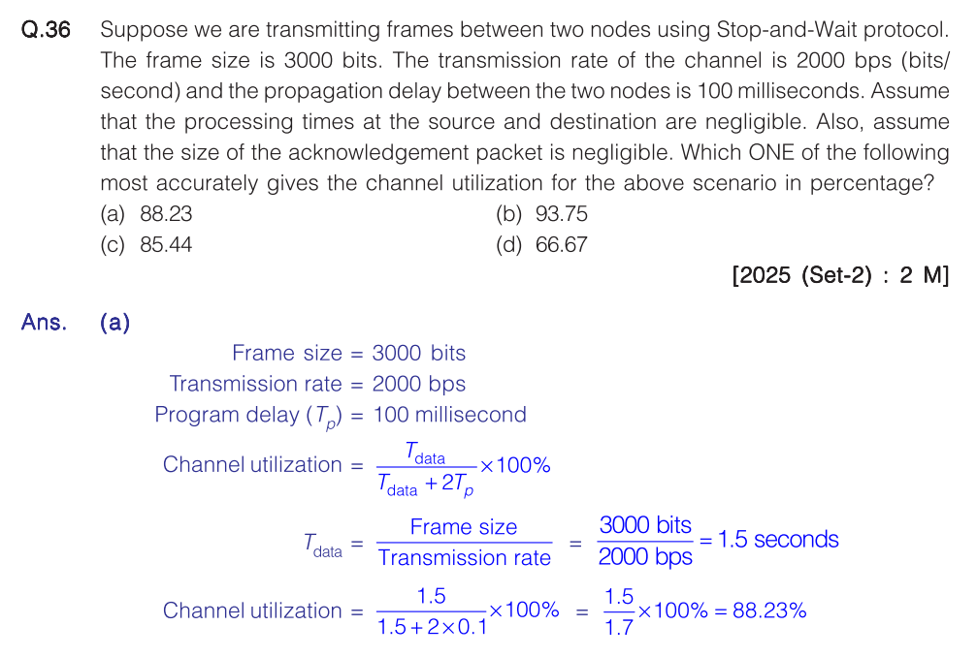

Slide 13
GATE 2024 01

Slide 14


